Slide 1
Management of pregnant women with a history of addictions/substance absuse

Slide 2
INTRODUCTION
⬆︎ drug use in developed world within the last three decades
Women dependent on illicit drugs → high demands on anesthetic and obstetric services - 80% more involvement for analgesic purposes
drug abuse
physiological changes of pregnancy
pathophysiology of pregnancy-related disease
poor fetal outcome
serious maternal morbidity (placental abruption)

Slide 3
INTRODUCTION
Interactions between anesthetic drugs and drugs of abuse
Sedating agents: ⬇︎ MAC
Stimulants: ⬆︎ MAC
Difficulties to predict the exact repercussions in the chemically-dependent patient.
IV drug abusers:
IV access may be difficult
⬆︎ prevalence of transmissible diseases: hepatitis, HIV

Slide 4
ALCOHOL
Presentations of pregnant patients with a history of alcohol abuse:
acute intoxication
withdrawal
chronic alcohol abuse

Slide 5
ALCOHOL
Acute alcohol intoxication
Chronic alcohol abuse
liver disease
coagulopathy
cardiomyopathy
⬇︎ drug metabolism
Acute alcohol withdrawal
fetal distress
maternal pulmonary aspiration
fetal distress
autonomic instability
seizures
cardiac failure
Neuraxial analgesia/anesthesia
General anesthesia
benzodiazepines/alpha-2 agonists- risk of neonatal respiratory depression
Safe and preferable
Liver dysfunction (coagulopathy)
Assessing/replacing fluid deficits
⬆︎ pulmonary aspiration
liver/cardiac failure

Slide 6
OPIOIDS
heroin
fentanyl
opioid-based analgesic medications
Several aspects of care:
analgesia
anesthesia
overdose/withdrawal

Slide 7
OPIOIDS
Withdrawal syndrome can occur within 4-6 hours of heroin use.
Withdrawal → ⬆︎ sympathetic NS activity → tachycardia, hypertension, restlessness
Recurring placental/fetal opioid withdrawal:
IUGR
placental abruption
fetal death
preterm labor
Maternal overdose:
respiratory depression
respiratory arrest
aspiration
Polysubstance abuse, and infection with hepatitis B, C and/or HIV

Slide 8
OPIOIDS
Neuraxial analgesia and anesthesia
exclude cellulitis, coagulopathy, sepsis, endocarditis, septic arthritis
higher infusion rate/dosage for epidural analgesia
ultrasound to aid peripheral IV access/central venous access
General anesthesia
Induction dose requirements:
⬆︎ with chronic opioid use
⬇︎ with acute ingestion
associated malnutrition → dose adjustment

Slide 9
OPIOIDS
Postoperative pain: exaggerated- difficult to control
Maintenance + ‘as required’ opioids
Non-pharmacologic approaches: ice pack, heating pad, local anesthetic application to the perineum, transverse abdominis plane (TAP) blocks
Acetaminophen: 650 mg q6h by mouth
Ibuprofen: 600 mg q6h by mouth
If unsuccessful: ketorolac: 15 mg/30 mg IV/IM q6h for 48 hours
Epidural morphine if there is a significant laceration repair
A short course of low-dose opioids

Slide 10
COCAINE
Commonly used in pregnancy in developed countries
Not specific to any particular cohort
Often co-abused

Slide 11
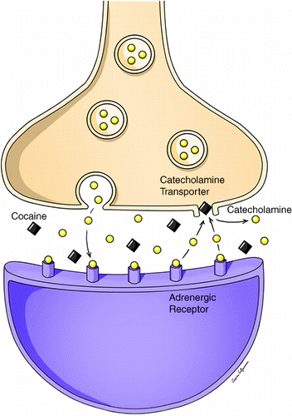
COCAINE
⬆︎ Cardiovascular sensitivity to cocaine in pregnancy → ⬆︎ myocardial oxygen demand:
myocardial ischemia
infarction
arrhythmias
Respiratory complications:
asthma
pulmonary hemorrhage
nasal septal collapse
4-fold increase in rates of emergency caesarean section following placental abruption and fetal distress

Slide 12
COCAINE
Other complications:
teratogenic effects
IUGR
preterm labor
Acute intoxication:
hypertension
seizures
hyper-reflexia
thrombocytopenia
proteinuria
edema
(pre-eclampsia?)

Slide 13
COCAINE
Other complications:
teratogenic effects
IUGR
preterm labor
serotonin syndrome
Acute intoxication:
hypertension
seizures
hyper-reflexia
thrombocytopenia
proteinuria
edema
The mortality of severe serotonin syndrome is estimated to range from 2% to 12%
(pre-eclampsia?)

Slide 14
COCAINE
Neuraxial techniques
Ideal method- cocaine-induced thrombocytopenia
Physiological alterations in pain perception → inadequate analgesia despite a functioning epidural catheter
Intrathecal opioids: ⬇︎ duration of action (abnormalities in mu and kappa opioid receptor densities as a result of cocaine addiction)
Phenylephrine is the preferred vasopressor as cocaine use can cause resistance to ephedrine.

Slide 15
COCAINE
Supplemental agents(s) to obtund the hypertensive response to laryngoscopy.
Labetalol
Nitroglycerine
Sodium nitroprusside
Magnesium + remifentanil/alfentanil
Benzodiazepines
Hydralazine
Propofol
thiopental
Not ketamine
⬆︎ effects of succinylcholine- cocaine metabolism depletes pseudocholinesterase
Cardiac arrhythmias, hypertension and myocardial ischemia in the peripartum period.

Slide 16
AMPHETAMINES
Sympathomimetic drugs - structurally resemble norepinephrine- profoundly serotoninergic
Methamphetamine:
most commonly abused drug in this class
utilized orally, IV, smoked

Slide 17
AMPHETAMINES
Acute intoxication → hypertension, seizures, hyperreflexia→ mistaken for pre-eclampsia
As with cocaine
Fetal and placental complications due to vasoconstriction → ⬇︎ utero-placental blood flow:
IUGR
placental abruption
preterm labor

Slide 18
AMPHETAMINES
Preferred method: neuraxial anesthesia
Hallucinogenic effects → prevent safe and controlled placement of a neuraxial block
Unpredictable Cardiovascular response to neuraxial anesthesia
Invasive arterial monitoring and titrated phenylephrine infusion should be considered.
General anesthesia … as cocaine abusers
Acute intoxication: ⬆︎ anesthetic requirements
Chronic abusers: ⬇︎ anesthetic requirements

Slide 19
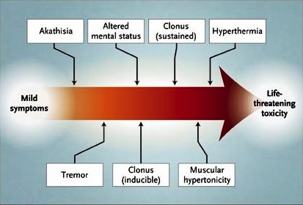
AMPHETAMINES
The patient’s temperature should be closely monitored → serotonin syndrome.

Slide 20
MARIJUANA
The most commonly abused drug in pregnancy after tobacco and alcohol
Commonly available
Now legal in many jurisdictions
Varies in potency

Slide 21
MARIJUANA
low doses: sympathetic activity
high doses: parasympathetic activity → bradycardia/hypotension
Acute intoxication:
affects cognitive/motor performance
ST and T wave changes
supraventricular/ventricular ectopic activity
Marijuana readily crosses the placenta:
IUGR
preterm labor

Slide 22
MARIJUANA
Neuraxial anesthesia: preferred mode
General anesthesia:
respiratory complications:
oropharyngeal/uvular edema → ⬆︎ difficult intubation
upper airway irritability → broncho/larnygospasm
IV dexamethasone as a prophylaxis
⬆︎ anesthetic agents affecting heart rate/blood pressure
⬆︎ effects of succinylcholine (⬇︎ cholinesterase activity)
cross-tolerance:
opioids
benzodiazepines
barbiturates

Slide 23
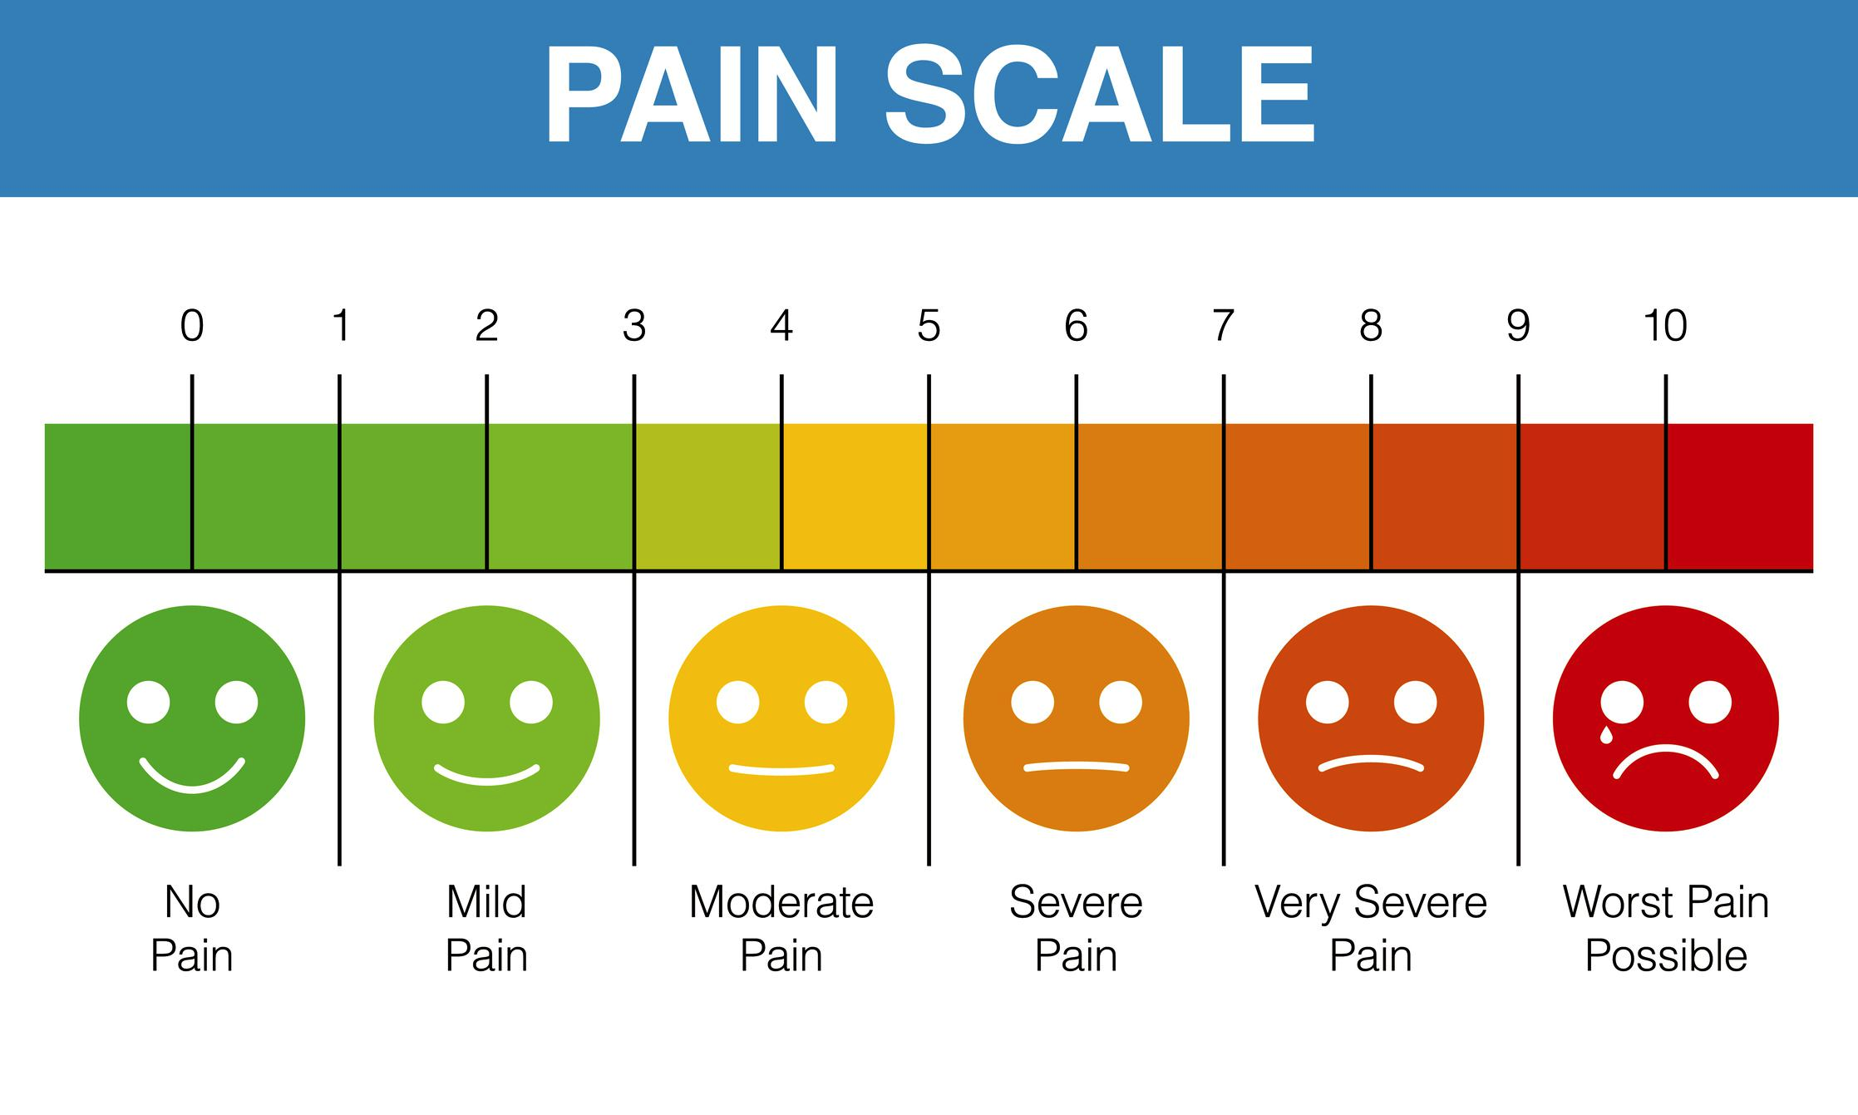
MARIJUANA
Analgesic effect is related to dose of marijuana:
low doses → do not affect pain levels
moderate doses → reduce pain scores
high doses → increased pain

Slide 24
KETAMINE AND OTHER HALLUCINOGENS
Ketamine
lysergic acid diethylamide (LSD)
phencyclidine (PCP)
Psilocybin mushrooms ’magic mushrooms’
Stimulate the SNS:
hyperthermia
hallucinations
anxiety

Slide 25
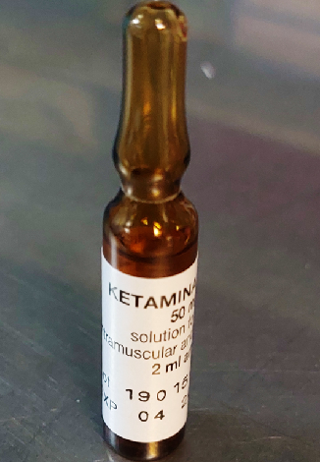
KETAMINE AND OTHER HALLUCINOGENS
Autonomic dysregulation:
labile blood pressure
tachycardia
coronary/cerebral vasospasm
Overdose:
respiratory depression
seizures/coma
water intoxication (LSD induced thirst) → pulmonary/cerebral edema, electrolyte abnormalities
hypertension/proteinuria +/- seizures (mistaken for pre-eclampsia)
hyperthermia: ⬆︎ maternal/fetal oxygen demand → fetal heat-induced neurological injury

Slide 26
KETAMINE AND OTHER HALLUCINOGENS
Neuraxial techniques: first choice in cooperative patients
Vasopressors should be used with caution to treat cardiovascular instability (exaggerated response)
General anesthesia: Hemodynamic instability is a primary concern
⬆︎ analgesic/ventilatory depressant effects of opioids
⬇︎ MAC requirements with ketamine abuse
PCP/LSD: ⬆︎ effects of succinylcholine (⬇︎ plasma cholinesterase)
⬆︎ postoperative anxiety/psychosis

Slide 27
Nicotine (Tobacco Products and e-Cigarettes
Nicotine readily crosses the placenta- concentrations in the blood of the fetus can be 15٪ higher than in the mother.
Smoking (even secondhand exposure) during pregnancy:
birth defects
premature birth
miscarriage
low birth weight

Slide 28
Nicotine (Tobacco Products and e-Cigarettes
⬇︎ oxygen levels
⬆︎ risk of heart-related complications after surgery
⬆︎ risk of post-surgical complications to the lungs
Delay healing, ⬆︎ risk of infection at the wound site

Slide 29
BREASTFEEDING
Generally advise not to breastfeed- lack of data on the correlation between concentrations in breast milk and effects on the infant.
Exceptions:
methadone
buprenorphine
alcohol abusers

Slide 30
BREASTFEEDING
Methadone:
transfer to breast milk is low
Buprenorphine:
concentration in breast milk is low
Other opioids:
caution is advised with codeine (CYP2D6 ultra-rapid metabolizers → high morphine metabolite levels)
Alcohol:
daily intake limited to no more than 60 mL of liquor, 236 mL of wine, or two average beers for a 60 kg woman.
In this case, nursing should take place at least 2 hours after drinking.

Slide 31
PSYCHOLOGICAL AND SOCIAL CONSIDERATIONS
Drug abuse is a significant social problem:
challenges in the peripartum period
obstetric morbidity/mortality

Slide 32
PSYCHOLOGICAL AND SOCIAL CONSIDERATIONS
Substance-abusing parturients are more likely to suffer:
poor general health
malnourishment
untreated coexisting disease
less likely to engage with antenatal care
poverty
domestic violence
physical and/or sexual abuse
mental illness
increase the risk of criminal activities
increase the likelihood of social service intervention (child protection orders)

Slide 33
SUMMARY

Slide 34
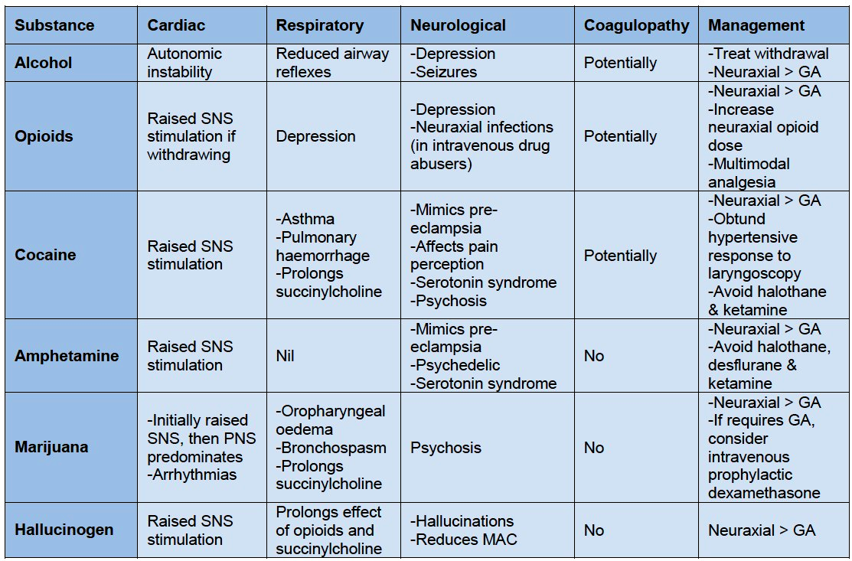

Slide 35
References
https://www.drugabuse.gov/download/18910/substance-use-in-women-research-report.pdf?v=b802679e27577e5e5365092466ac42e8
https://www.who.int/news/item/20-01-2020-smoking-greatly-increases-risk-of-complications-after-surgery
https://doi.org/10.1016/j.ajog.2019.03.022
https://resources.wfsahq.org/atotw/management-of-pregnant-women-with-a-history-of-addictions-or-substance-misuse/
Reece-Stremtan S, Marinelli KA. ABM clinical protocol #21: guidelines for breastfeeding and substance use or substance use disorder, revised 2015. Breastfeed Med. 2015 Apr;10(3):135-41. doi: 10.1089/bfm.2015.9992. PMID: 25836677; PMCID: PMC4378642.
Frank C. Recognition and treatment of serotonin syndrome. Can Fam Physician. 2008;54(7):988-992.

